Slide 1

Term I project - EDA
Analysing the movies database

Slide 2
Problem statement
Perform Exploratory data analysis on the Movies dataset and provide insights into the various relationships available in the data.
The dataset is a collection of 1000 movies released between the decade starting 2006

Slide 3
Data loading and description
Examining the data provides us with the following information about the structure and type
Type of variable | Data type | Variable category
Predictor Variable Genre Director Actor Year Runtime Rating Votes Metascore | Character Title Genre Description Director Actors | Categorical Director Genre Actors Runtime
Target Variable Revenue | Numeric Year Runtime Rating Votes Revenue Metascore | Continuous Year Rating Votes Revenue Metascore

Slide 4
Data profiling – pre processing
Running pandas_profiling on the data provides us with the following insights:
Metascore column is missing data(64) and we could consider ignoring this column. Metascore correlation with Rating is pretty high and hence ignoring this should not impact the model much
Revenue column is also missing data(128), but we should still consider it since it adds significant value
Genre is broken down into multiple columns since it is captured as a list in a column
Similarly Actors is broken down into multiple columns since it is captured as a list in a column
Ratings are between 1 to 10

Slide 5
Data profiling – Understanding the dataset
Convert Genres into three columns for grouping
Most successful group of actors
Two categorical variable – Bar chart
Two continuous variables – Scatter plot
One continuous, one categorical – Side by side box plot
Col Name | Data type | Chart
Rank | Index
Title | Categorical/Nominal | Bar, Pie
Genre | Categorical/Nominal | Bar, Pie
Description | Categorical/Nominal | Bar, Pie
Director | Categorical/Nominal | Bar, Pie
Actors | Categorical/Nominal | Bar, Pie
Year | Interval data | Histogram, Box Plot
Runtime (Minutes) | Numeric/Ordinal data
Rating | Numeric/Ordinal data | Histogram, Box Plot
Votes | Numeric/Ordinal data | Histogram, Box Plot
Revenue (Millions) | Numeric/Ordinal data | Histogram, Box Plot
Metascore | Ordinal data | Histogram, Box Plot

Slide 6
Data profiling – pre processing
Below are the steps involved to understand, clean and prepare your data for building your predictive model:
Variable Identification
Univariate Analysis
Bi-variate Analysis
Missing values treatment
Outlier treatment
Variable transformation
Variable creation
https://www.analyticsvidhya.com/blog/2016/01/guide-data-exploration/

Slide 7
Data profiling – post profiling
Renaming columns for ease of use
Runtime (Minutes) to Runtime
Revenue (Millions) to Revenue
Converting time to timescale
Splitting Genre into three separate columns
Splitting Actor into four separate columns

Slide 8
Questions
Have scores become better or worse with the years?
Find out the top five genres by rank, rating and revenue
Find out the top 5 bankable actors and directors
Does runtime impact the revenue of the movie
Is there any correlation between the revenue and the critics ratings
Did any calamity have any impact on the revenue of the movies
Word cloud of the actors
Preferred actor for a director

Slide 9
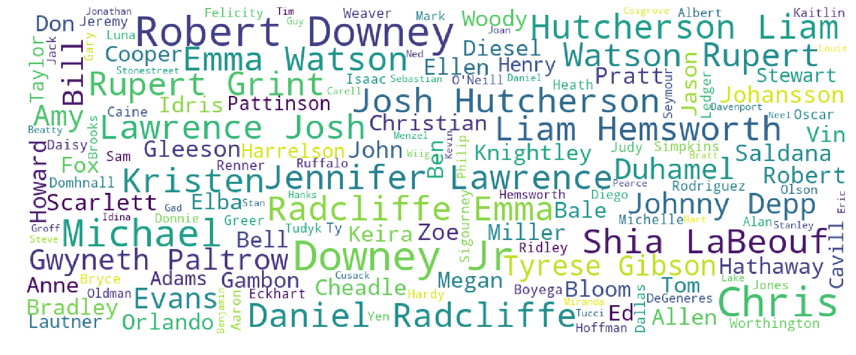
Word cloud of top 50 actors – By revenue

Slide 10
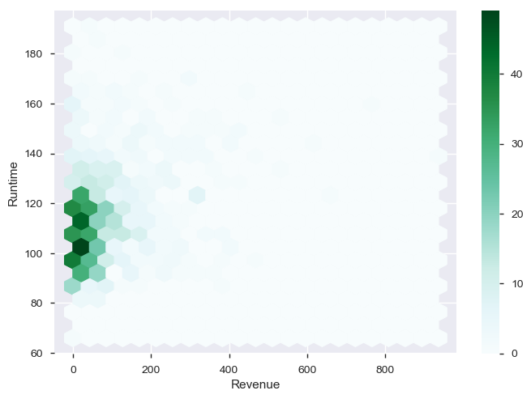
Revenue and runtime
As can be seen from the plot most of the movies have a run time of around 100 minutes
Majority of the movies lie between 90 to 120 minutes

Slide 11
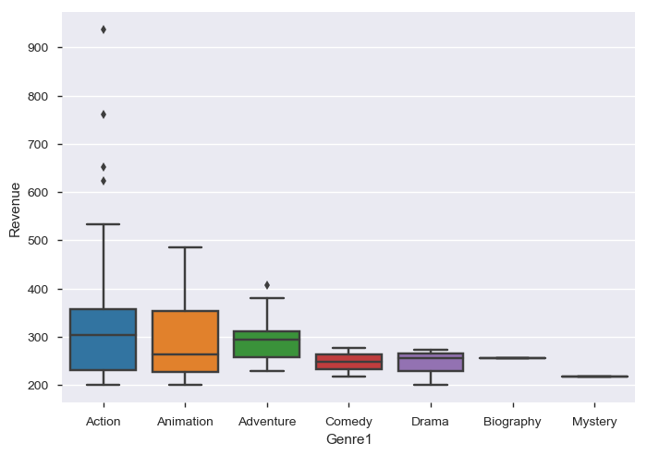
Box plot of Genre and revenue
Action and Animation seems to be the most revenue generating genre’s closely followed by Adventure
Biography and Mystery are the least revenue generating genres
There are a number of outliers in the Action genre which reinforces the insight that Action is the most profitable

Slide 12
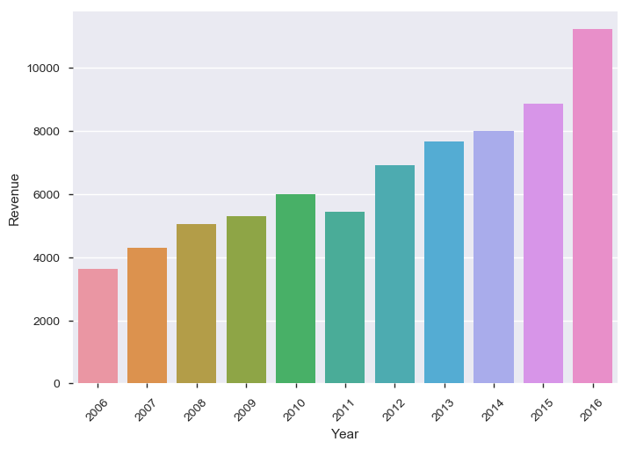
Revenue vs Year
The movie collections are going up year on year. 2011 is an anomaly
Can conduct further experiments to confirm if this is due to the 2011 WTC incident
Another experiment can be to find out any impact of natural calamites on the movie collections

Slide 13
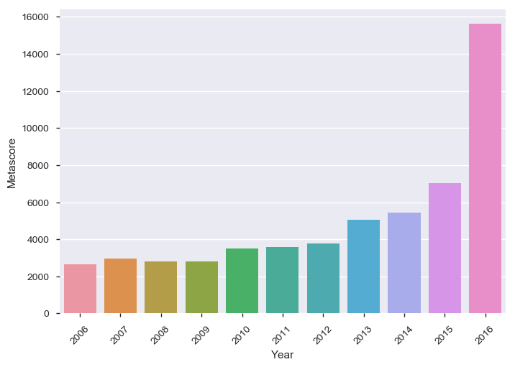
Metascore vs Year
Metascores have exponentially gone up from 2015 to 2016
A similar increase is not viewed in the Revenue
A follow up experiment should provide more insights on how Metascores are or are not correlated to the revenue

Slide 14
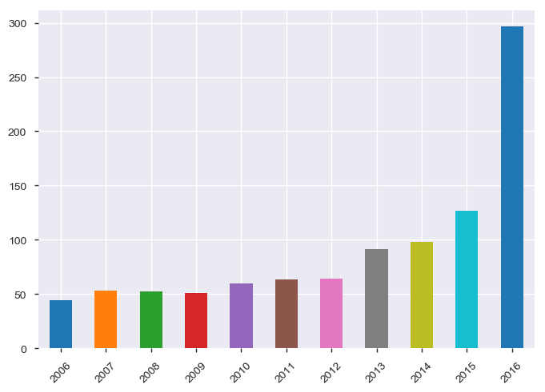
Movies per year
The number of movies produced every year showed a gradual increase till 2015
Between 2015 and 2016 the number of movies produced has doubled as per the data provided

Slide 15
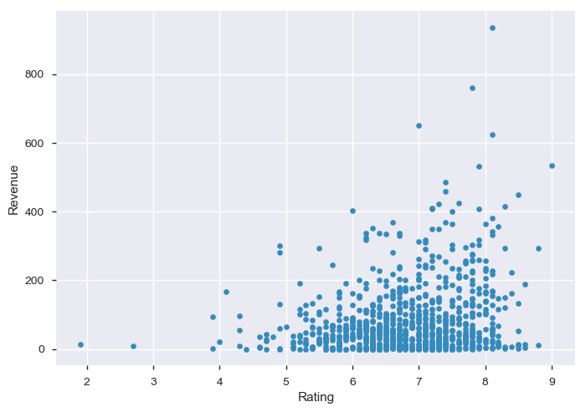
Ratings vs revenue - correlation
There does not seem to be much correlation between the ratings and the revenue
The data readings have a large spread

Slide 16
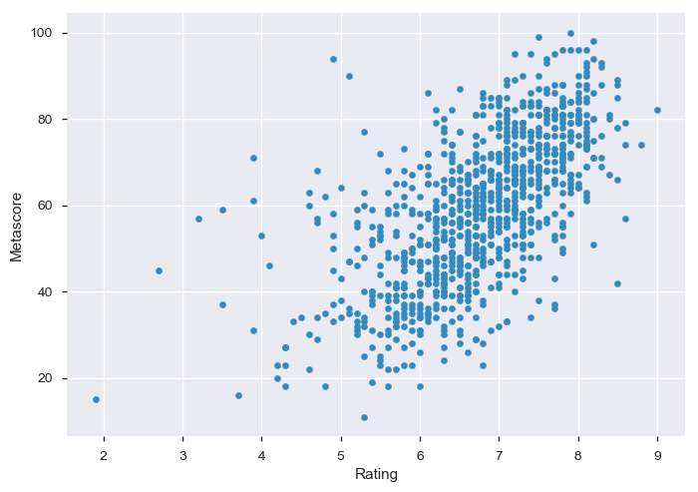
Ratings vs Metascore - correlation
Highly correlated looking at the tightly packed readings in the data
We could consider dropping metascore for further analysis since there are missing values as well as good correlation with rating data

Slide 17
conclusions
Top bankable actor is Robert Downey Jr. followed by Daniel Radcliffe
Action and Animation are the most revenue generating genres followed closely by Adventure
Biography and Mystery are the least revenue generating genres
There are a number of outliers in the Action genre which reinforces the insight that Action is the most profitable
The movie collections are going up year on year. 2011 is an anomaly
Metascores have exponentially gone up from 2015 to 2016, however this increase does not reflect in the Revenues
The number of movies produced every year showed a gradual increase till 2015, but between 2015 and 2016 the number of movies produced has doubled
There does not seem to be any correlation between Revenue and Runtime
There does not seem to be any correlation between Revenue and Ratings
Ratings and Metascore is highly correlated

Slide 18

Thank You
tohrishi@gmail.com

